Slide 1

CVR COLLEGE OF ENGINEERING
Department of Emerging Technologies
Sudoku Challenger
Team Members:
T Rohan Reddy – 22B81A6697
K Sai Shyam Sundar Rao – 22B81A66A8
D Sai Srujan – 22B81A66A9

Slide 2
Abstract
Basic aim of the project is to build a sudoku puzzle for the users and provide them with the right answers to the puzzle to verify whether it is appropriate or not.
Basic 3 principles in sudoku are :-
In all 9 submatrices 3x3 the elements should be 1-9 without repetition.
In all rows there should be elements between 1-9 without repetition.
In all columns there should be elements between 1-9 without repetition.

Slide 3
Introduction
This project contains a sudoku puzzle which is newly generated every time the user asks for.
This project is developed using Java, HTML & CSS.
Java’s AWT & Swing technology is being used for generating sudoku’s layout and HTML & CSS is used to make the game available to all to play using browser.

Slide 4
Key Features
User Interface:
Generate sudoku puzzle for the user to solve. User gets 3 options to select difficulty (Easy , Medium , Hard).
User Input:
Based upon the user's choice the spaces in the puzzle will be generated. As the difficulty increases empty spaces also increases.
Generated Output:
Give solution to the generated puzzle to the user after completion of the puzzle. The solution to the puzzle is displayed on the screen for the user.

Slide 5
Software Requirements
Languages: Java , HTML & CSS
Tools/IDEs: VS Code
Operating System: Windows 10

Slide 6
Hardware Requirements
RAM: 4GB or higher
SSD Size: 128MB or higher
Processor: intel i3 or higher
(All these are recommended requirements for good experience)

Slide 7
Existing Methodology
There are many methodologies that were involved in generating sudoku that were implemented before.
Generating sudoku is also created using different languages like python, java script, Kotlin etc.
Some of the existing technologies are:
Back Tracking Algorithm
Stochastic search
Constraint programming
Exact cover
Relations and Residuals.

Slide 8
Proposed Methodology
The technologies that are being used for the current project are:
Java AWT and SWINGS
Back Tracking Algorithm.

Slide 9
Algorithms/Techniques
Back Tracking Algorithm:
It assigns numbers from 1 to 9 to empty cells, checking if each number is valid.
If there’s a violation of rules (i.e., same number in the same row, column, or 3x3 sub grid), it backtracks and tries a different number.
The algorithm recursively explores all possible solutions until a valid solution is found.

Slide 10
Technology Description
Overview
This project entails the development of a Java-based Sudoku application with GUI capabilities to generate, solve, and validate Sudoku puzzles at varying difficulty levels. The application uses the Swing framework for the user interface and employs algorithms for puzzle generation and solving.

Slide 11
Key Features
1. Sudoku Generator:
Puzzle Generation: Create puzzles with different difficulty levels (Easy, Moderate, Hard) by adjusting the number of pre-filled cells.
Randomization: Utilize algorithms to generate a wide range of unique puzzles.
Difficulty Adjustment: Allow users to choose the difficulty level, which impacts the puzzle's complexity.
2. Sudoku Solver:
Backtracking Algorithm: Implement a backtracking algorithm to solve puzzles efficiently.
Input Validation: Check user inputs for validity and provide visual feedback.
Real-time Solving: Solve user-input puzzles and display the solution instantly.

Slide 12
3. User Interface:
Interactive Grid: Allow users to input numbers and interact with the puzzle grid.
Level Selection: Provide an intuitive interface for selecting puzzle difficulty levels.
Controls: Include buttons for generating puzzles, resetting the grid, solving the puzzle, and navigating between game screens.
4. Additional Features:
Highlight Invalid Inputs: Indicate incorrect user inputs visually.
Non-editable Pre-filled Cells: Prevent modification of pre-filled cells to avoid mistakes.
User Guidance: Provide feedback and hints to assist users in solving puzzles.

Slide 13
Technical Stack
Java Swing:
GUI Components: Use Swing components (JFrame, JPanel, JButton, JTextField, etc.) to build the user interface.
Event Handling: Implement ActionListener for handling button clicks and other user interactions.
Layouts: Use various layout managers (BorderLayout, GridLayout, etc.) to organize the interface elements.
Algorithms:
Puzzle Generation Algorithm: Implement a custom algorithm for generating Sudoku puzzles with varying levels of difficulty based on the number of initially filled cells.
Backtracking Algorithm: Utilize backtracking for solving the Sudoku puzzles, ensuring correctness by checking the validity of each input during the solving process.
Input Validation: Implement validation logic to ensure user inputs conform to Sudoku rules.

Slide 14
Workflow and Architecture
User Interface Setup:
Level Selector Panel: Create a panel for selecting difficulty levels (Easy, Moderate, Hard) with custom-styled buttons.
Game Panel: Create a panel for the Sudoku grid and control buttons (Generate, Reset, Solve, Back to Level Selection).
Dynamic Panel Switching: Implement functionality to switch between the level selector panel and the game panel based on user actions.
Puzzle Generation:
Difficulty Level Selection: User selects a difficulty level, triggering the generation of a new puzzle.
Grid Initialization: Initialize the Sudoku grid with the generated puzzle, ensuring pre-filled cells are non-editable.
Puzzle Solving:
User Input: Users input numbers into the Sudoku grid.
Validation: Validate the inputs and highlight any incorrect values.
Solving Mechanism: Use the backtracking algorithm to solve the puzzle and display the solution.
Reset and Navigation:
Reset Functionality: Clear the current grid to allow users to start over.
Back Navigation: Provide a way to return to the level selection screen from the game panel.

Slide 15
3.1 Algorithm and Code snippets
We can observe that all 3 x 3 matrices, which are diagonally present are independent of other 3 x 3 adjacent matrices initially, as others are empty.
3 8 5 0 0 0 0 0 0 9 2 1 0 0 0 0 0 0 6 4 7 0 0 0 0 0 0 0 0 0 1 2 3 0 0 0 0 0 0 7 8 4 0 0 0 0 0 0 6 9 5 0 0 0 0 0 0 0 0 0 8 7 3 0 0 0 0 0 0 9 6 2 0 0 0 0 0 0 1 4 5
So if we fill them first, then we will only have to do box check and thus column/row check not required.
Following is the improved logic for the problem. 1. Fill all the diagonal 3x3 matrices. 2. Fill recursively rest of the non-diagonal matrices. For every cell to be filled, we try all numbers until we find a safe number to be placed. 3. Once matrix is fully filled, remove K elements randomly to complete game.

Slide 16
Sudoku Generator
public void fillValues()
{
// Fill the diagonal of SRN x SRN matrices
fillDiagonal();
// Fill remaining blocks
fillRemaining(0, SRN);
// Remove Randomly K digits to make game
removeKDigits();
}
int randomGenerator(int num)
{
return (int) Math.floor((Math.random()*num+1));
}
These above methods are used to generate the sudoku puzzle. Here we use Random class present in java to get random numbers.

Slide 17
Difficulty level:
We will choose difficulty based on the empty boxes the user have to fill. As the difficulty increases empty boxes also increase.
public void removeKDigits(){
int count = K;
while (count != 0) {
int cellId = randomGenerator(N*N)-1; // System.out.println(cellId); // extract coordinates i and j int i = (cellId/N);
int j = cellId%N; // System.out.println(i+" "+j);
if (mat[i][j] != 0) {
count--;
mat[i][j] = 0;
}
}
}

Slide 18
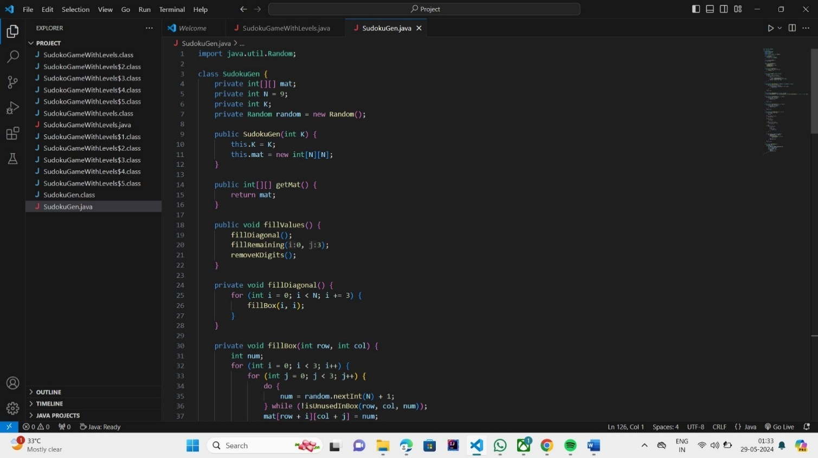
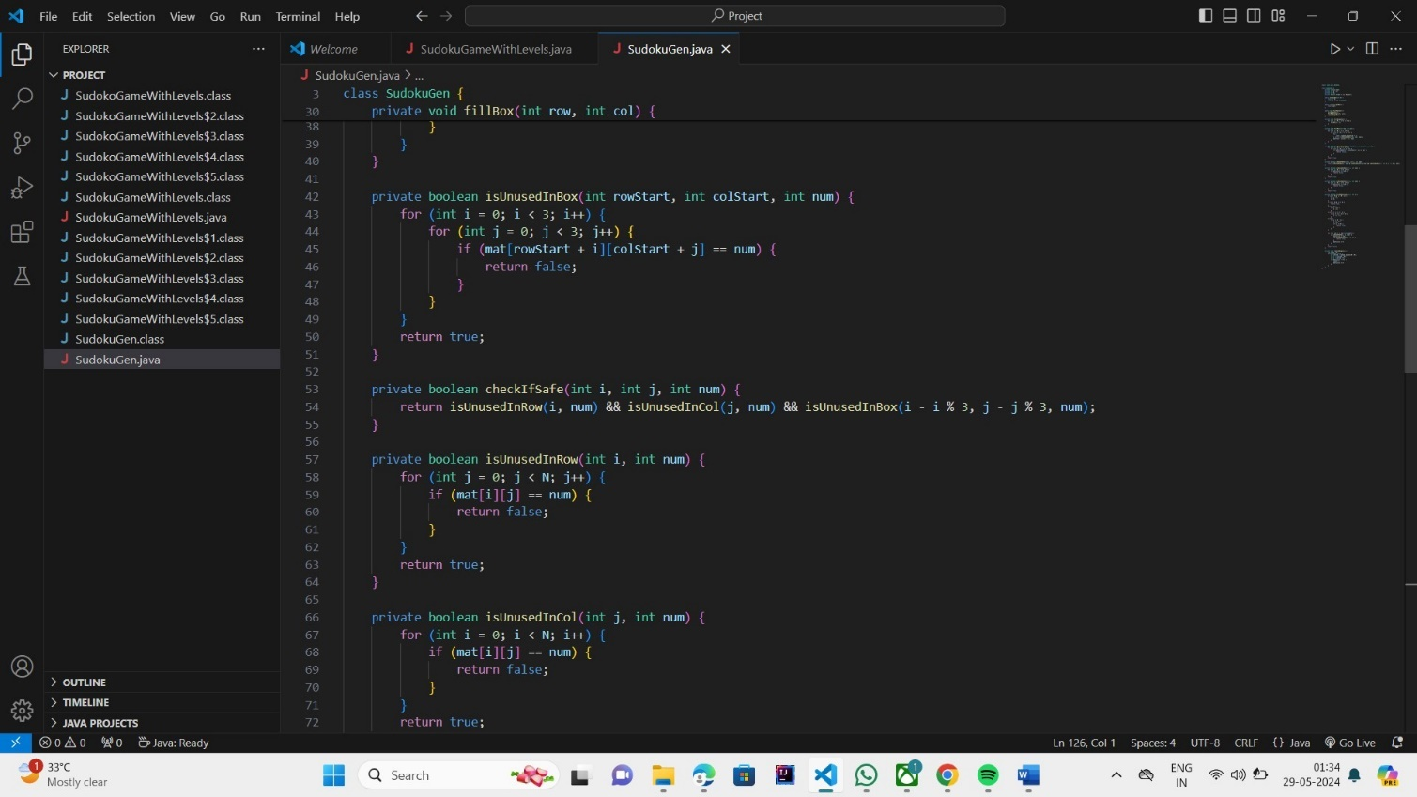
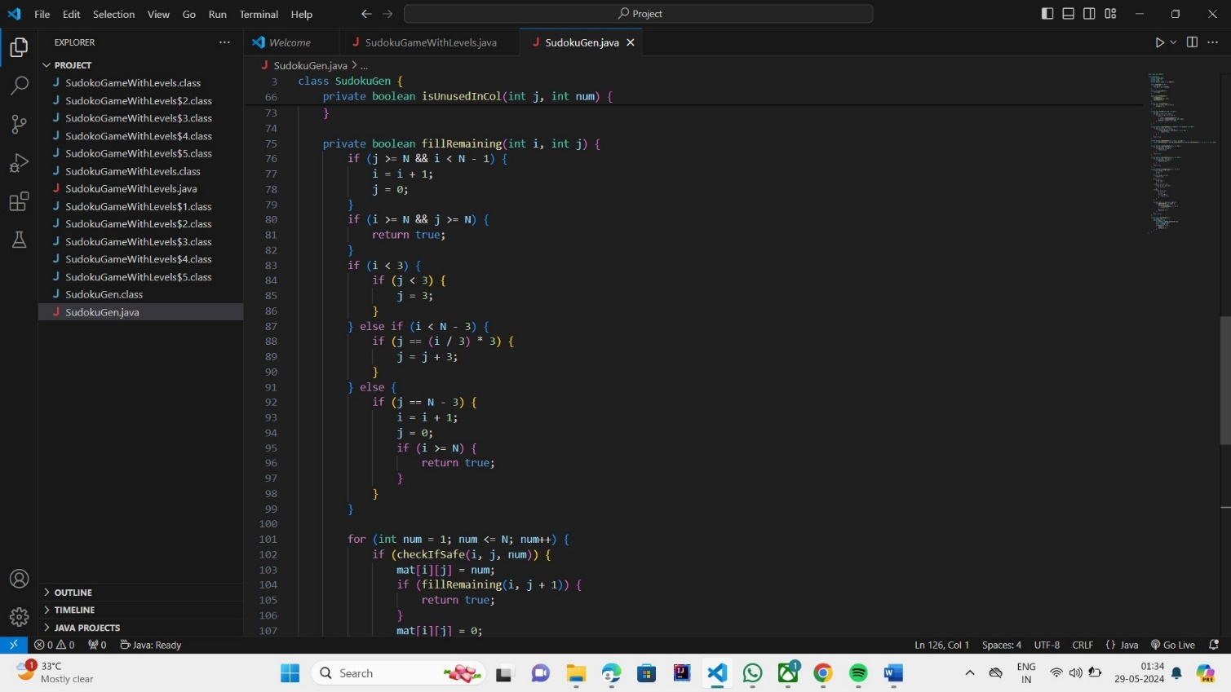
3.1.3 Deployment stage

Slide 19
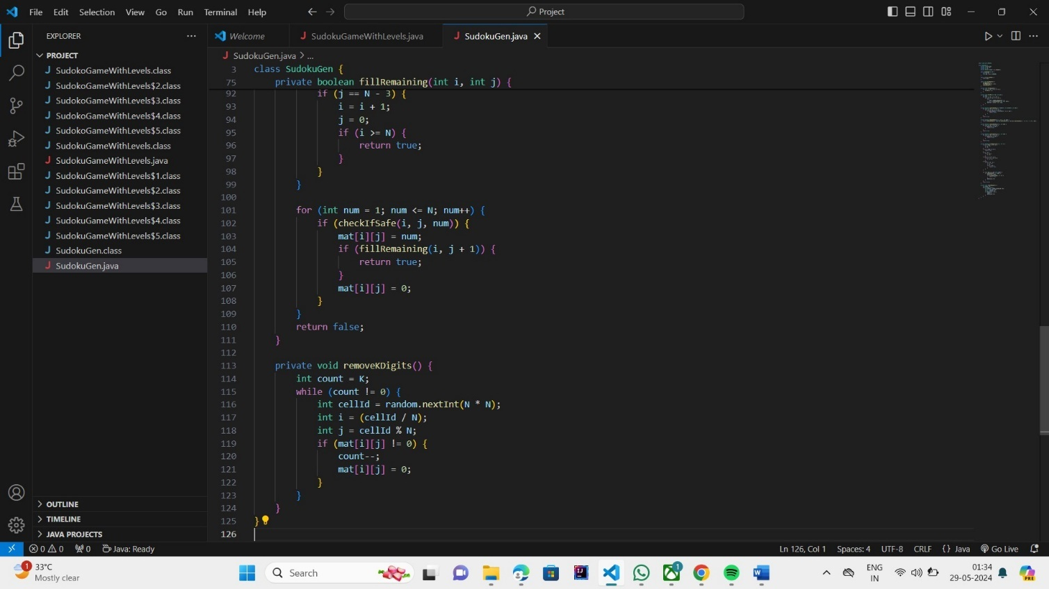
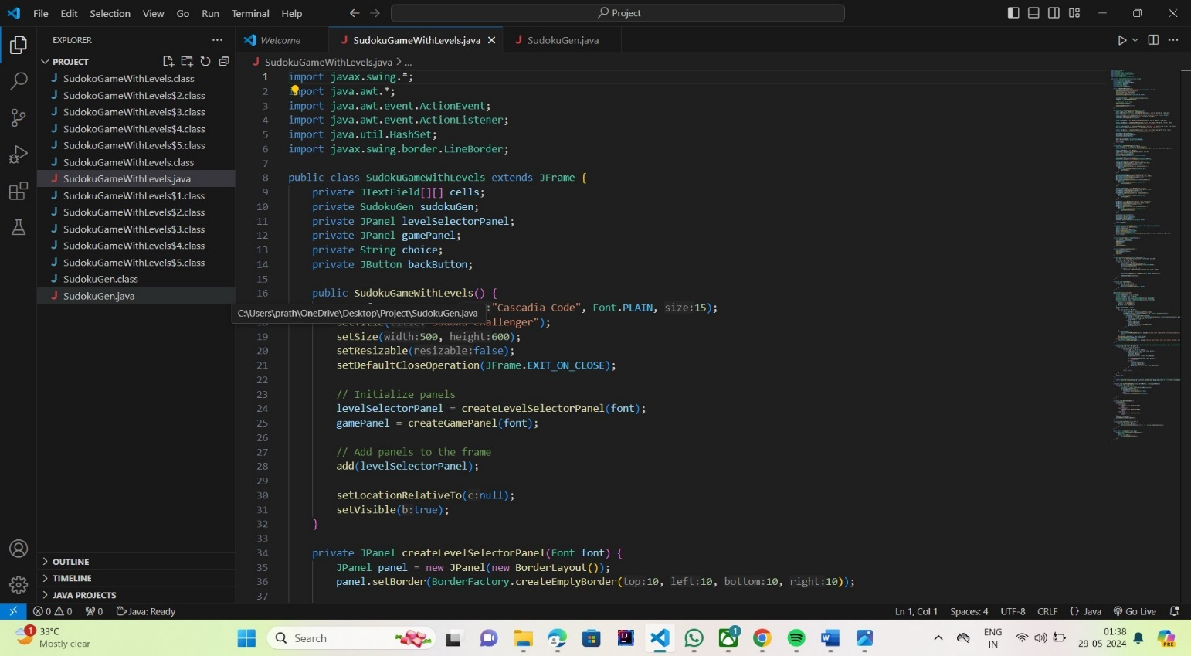
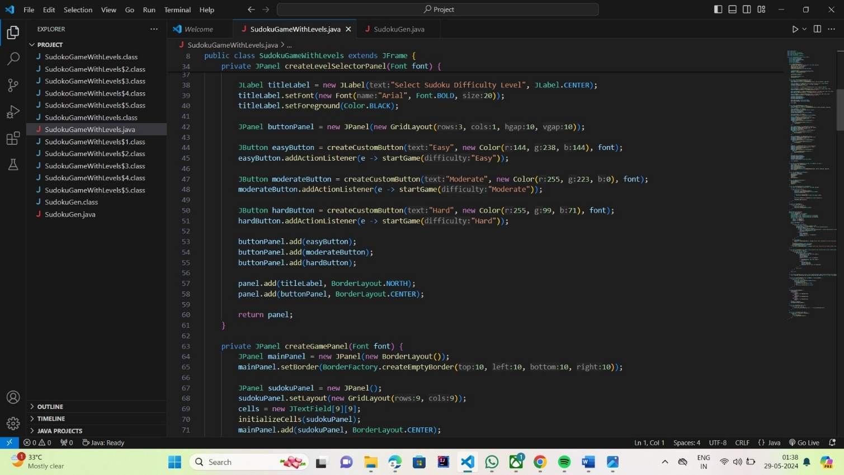

Slide 20
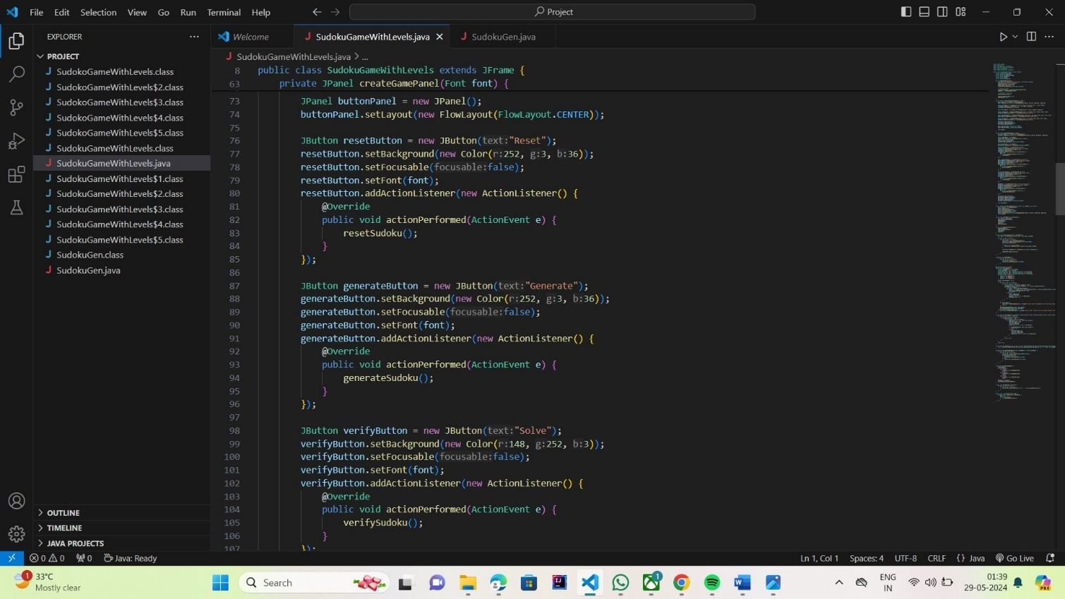
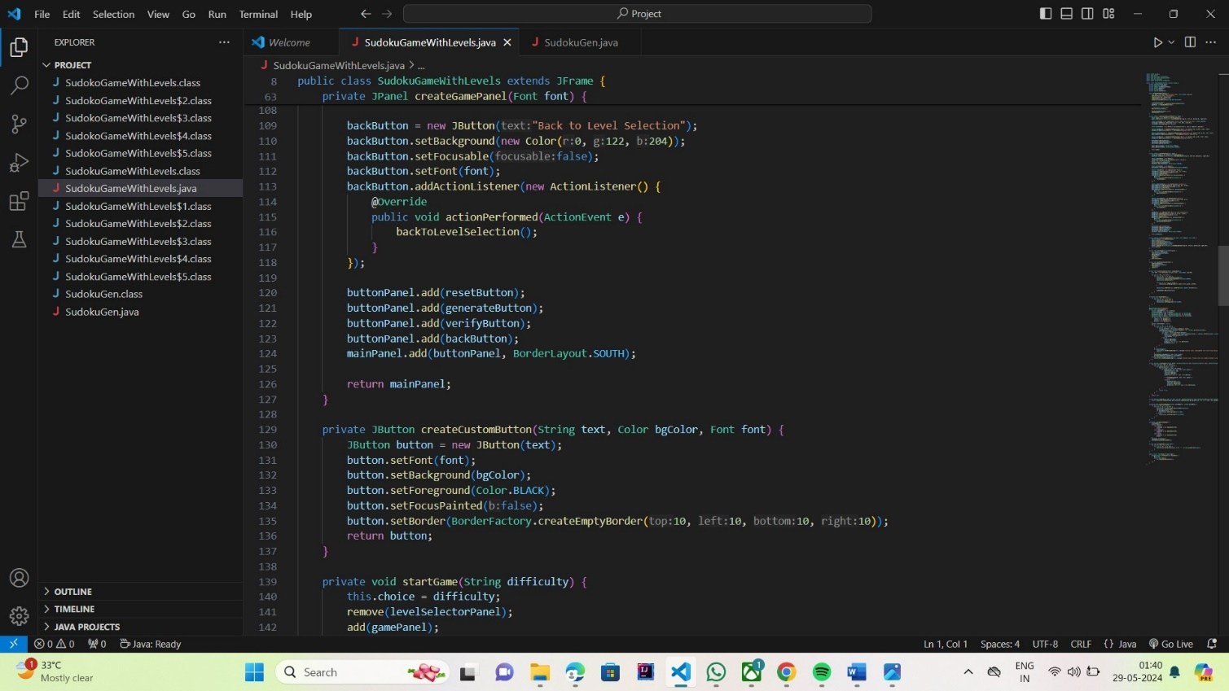

Slide 21
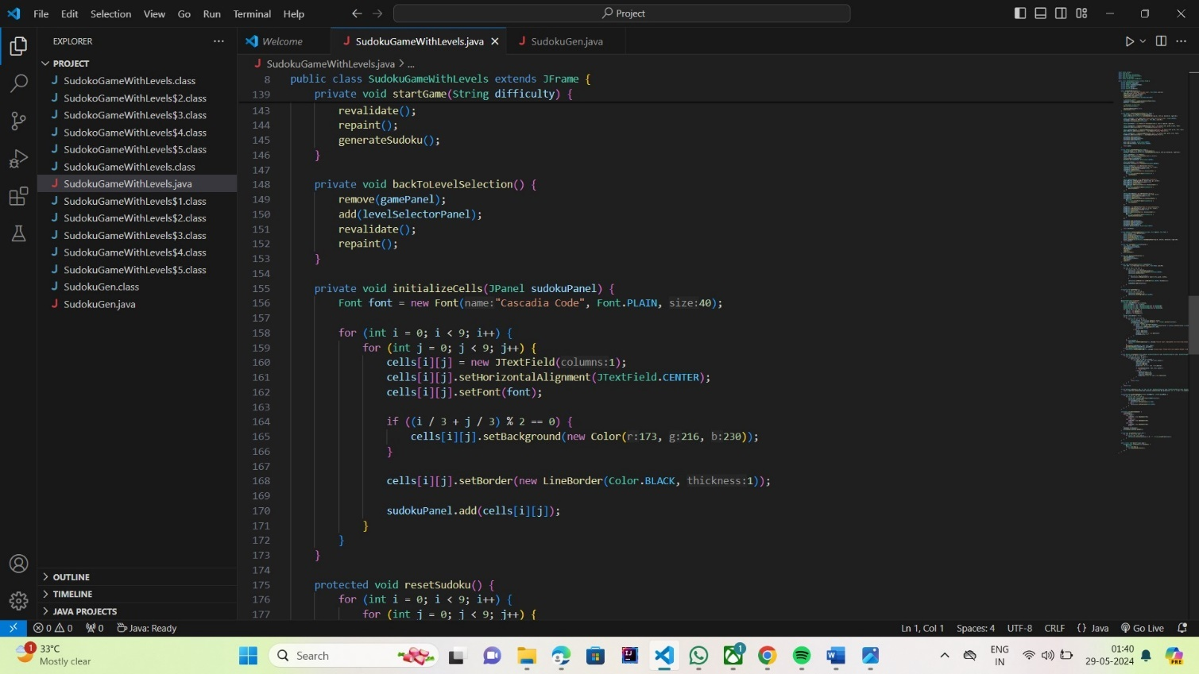
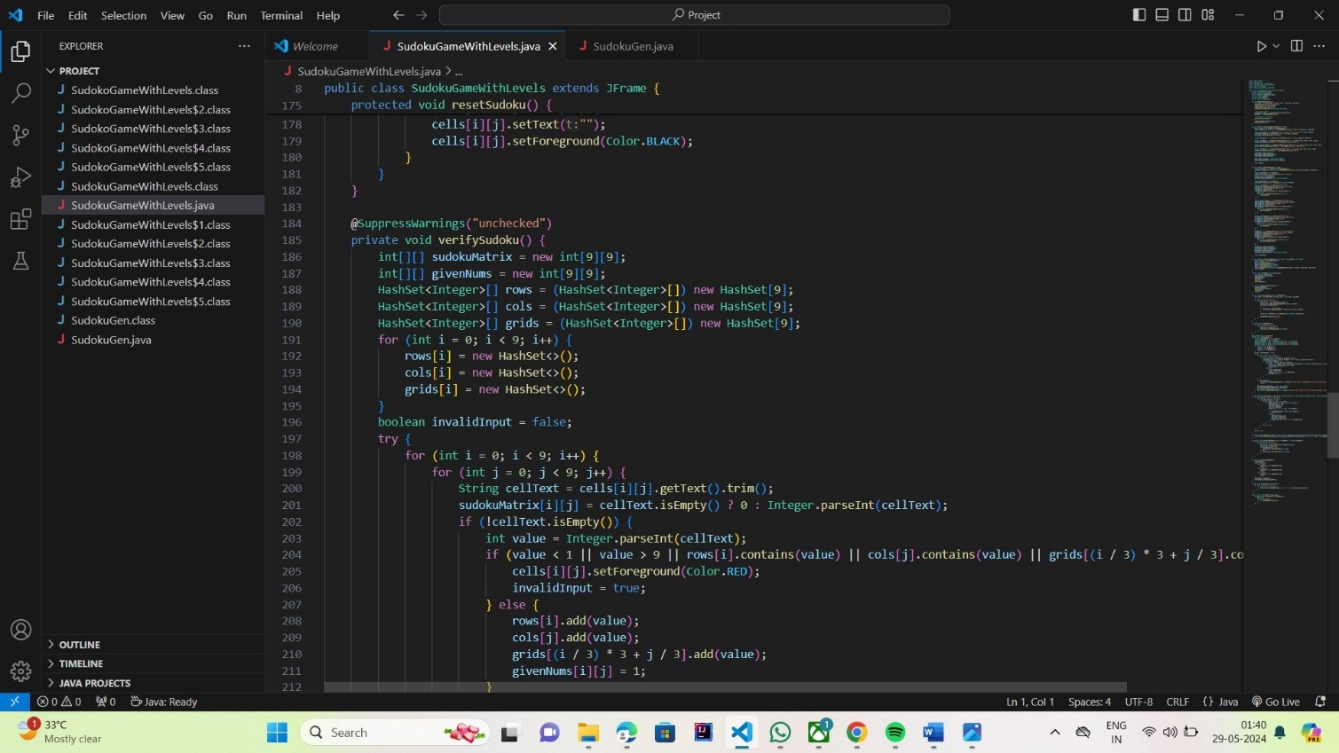
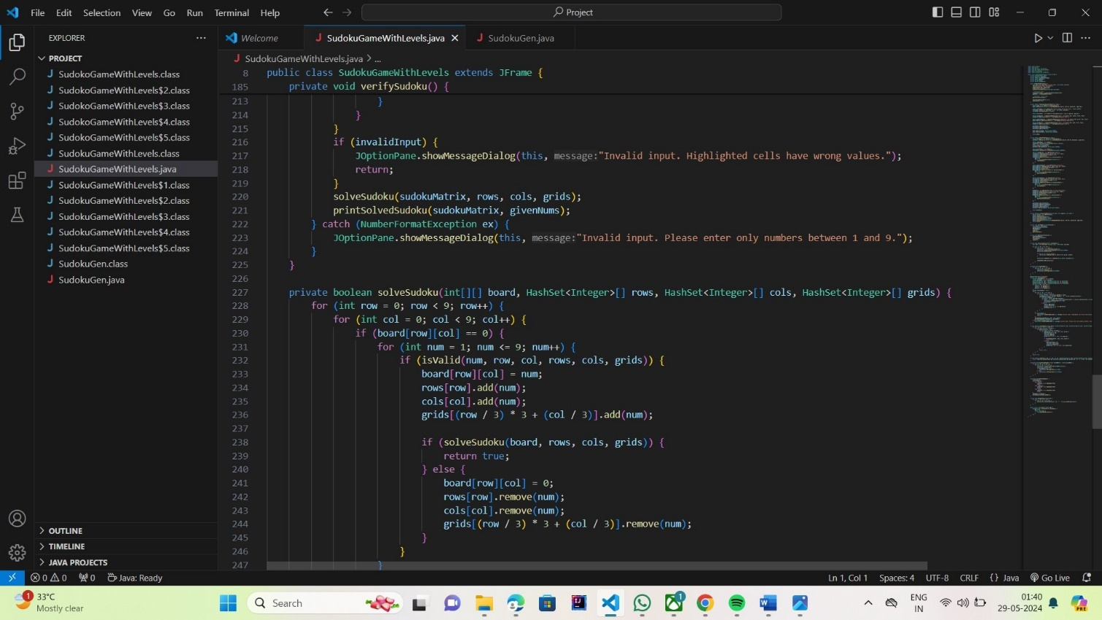

Slide 22
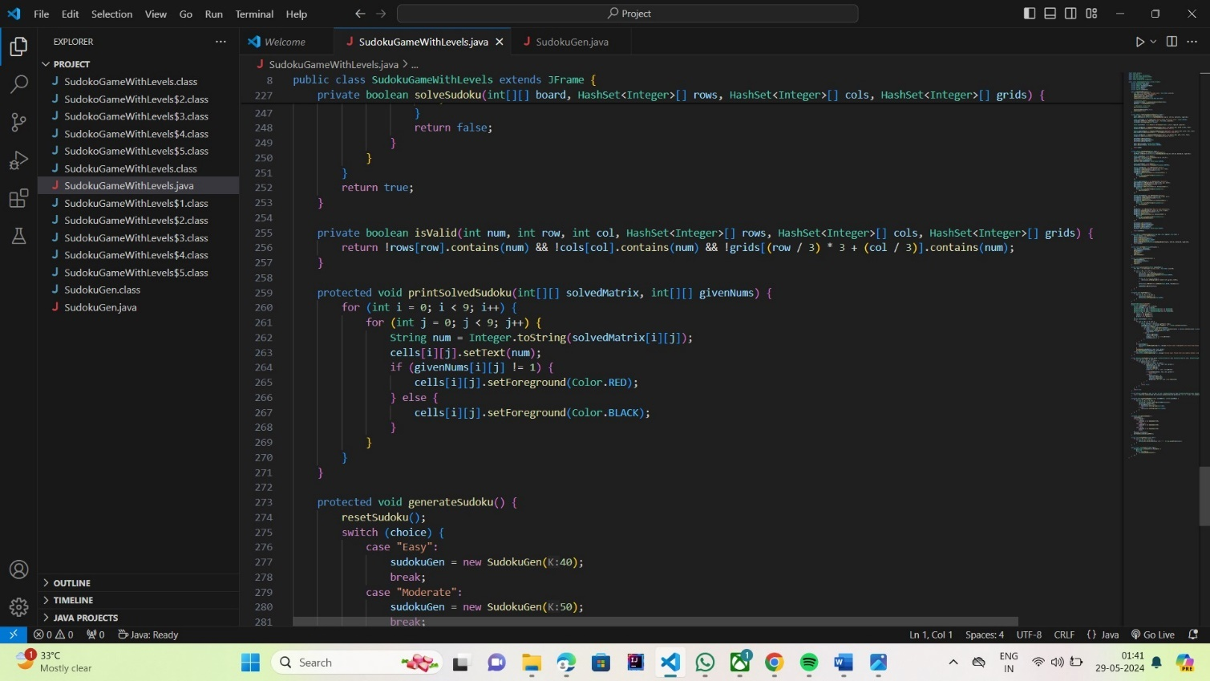
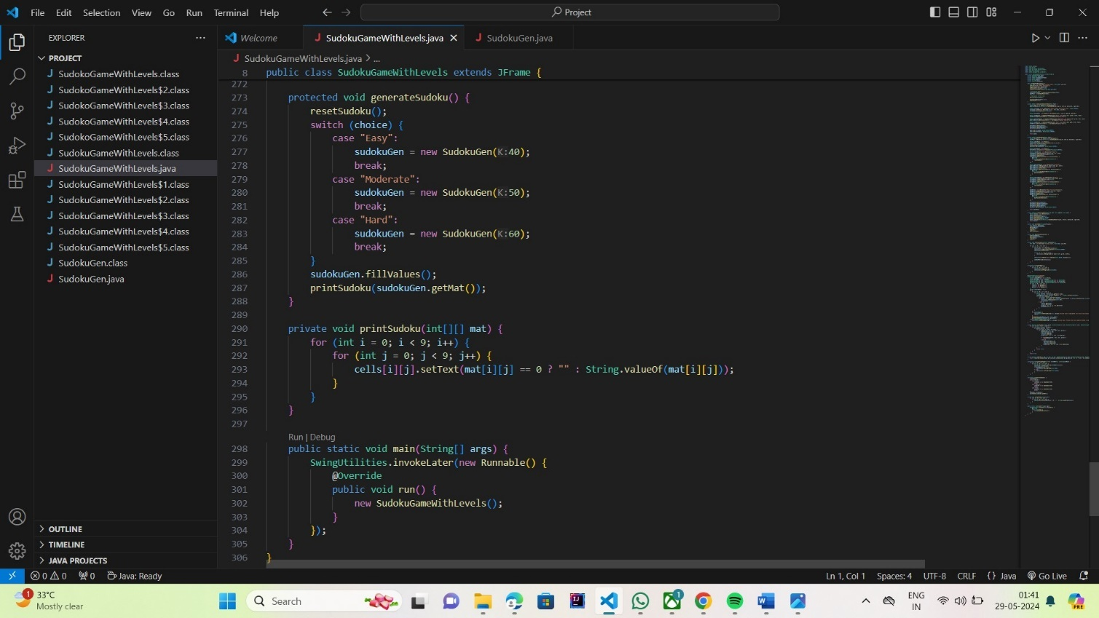

Slide 23
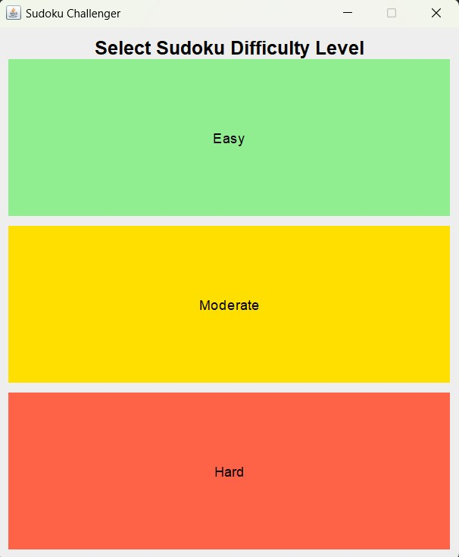
Test Cases
The figure shows that the user will be given 3 options of 1.Easy 2.Moderate 3.Hard to choose the difficulty.

Slide 24
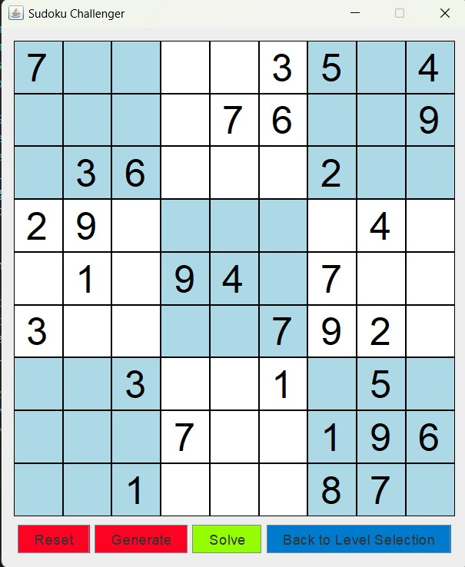
The figure shows the generated sudoku puzzle of the respective difficulty. User is also provided with certain features of Reset,Generate,Solve,Back to Level Selection.

Slide 25
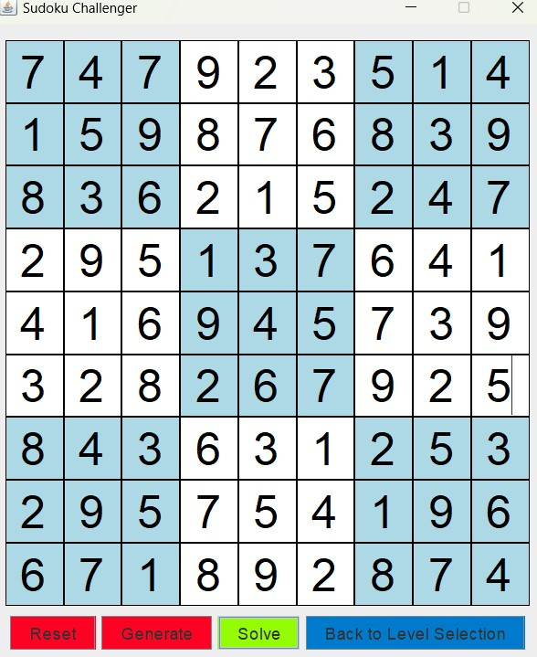
The figure is a demo puzzle filled by a user.

Slide 26
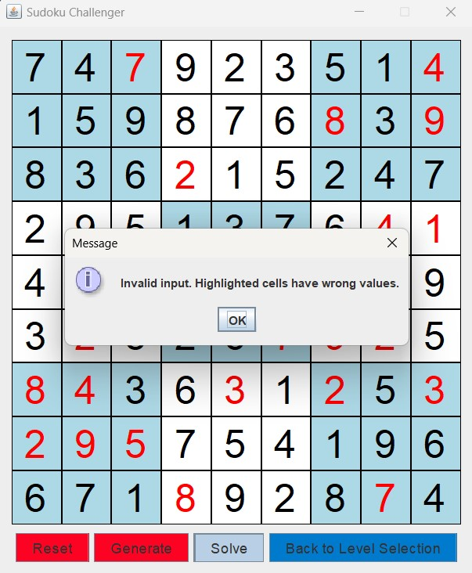
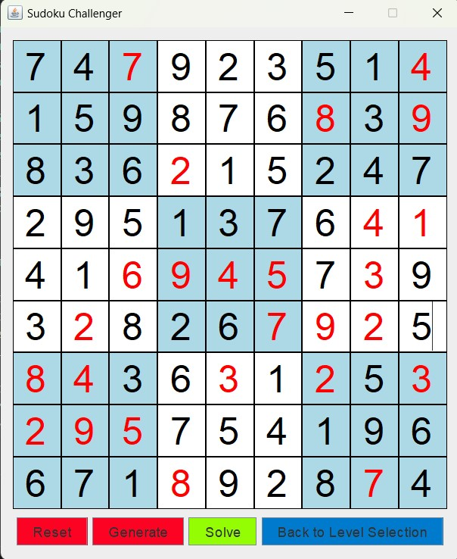
The figure shows that the user entered values are incorrect and the incorrect one’s are highlighted.

Slide 27
BIBILIOGRAPHY
1.Java: The Complete Reference 12th edition by Herbert Schildt.
About the book
Java™: The Complete Reference, Twelfth Edition explains how to develop, compile, debug, and run Java programs.This book covers the entire Java language, including its syntax, keywords, and fundamental programming principles. You’ll also find information on key portions of the Java API library, such as I/O, the Collections Framework, the stream library, and the concurrency utilities. Swing, JavaBeans, and servlets are examined, and numerous examples demonstrate Java in action.
2.Java Swing Tutorial- javatpoint and Geeks for geeks
Retrieved From: https://www.javatpoint.com/java-swing , https://www.geeksforgeeks.org/introduction-to-java-swing/
3.Sudoku Generator Algorithm – 101 Computing
Retrieved From: https://www.101computing.net/sudoku-generator-algorithm/
4.BackTracking Algorithm -Geeks for geeks
Retrieved From: https://www.geeksforgeeks.org/backtracking-algorithms/

Slide 28
CONCLUSION
This project aims to deliver a robust and efficient Sudoku solver capable of handling a wide range of puzzles. By focusing on accuracy, performance, and user experience, application will provide valuable assistance to Sudoku enthusiasts and contribute to the field of puzzle-solving algorithms.

